Slide 1
Working with Cambodian Refugees, Immigrants, and their Families: Utilizing a Culturally Informed Approach to Mental Health
Presented by
Bophal Phen, LCSW, LAADC

Slide 2
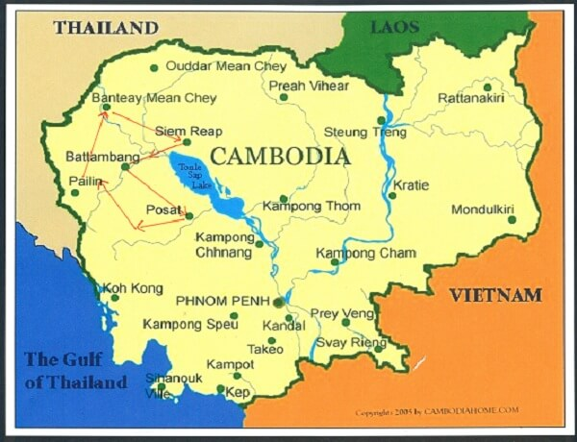
Cambodia: The Kingdom of Wonder
Located in Southeast Asia, with a current population of 16 million.
Sandwiched between its two bigger and more powerful neighbors: Thailand to the Northwest and Vietnam to the East.
Known for having a huge number of ancient temples and ruins (e.g., Angkor Wat, Bayon, Preah Vihear).
Thousands of them, big and small, built between the 7th and 13th century.
Because of these breathtaking temples, Cambodia was (and still is) the "Kingdom of Wonder”.
But this Kingdom of Cambodia has a dark history.

Slide 3
Cambodia's Recent Dark History with Tragedies
We, Cambodians, had lived through tragic events after tragic events
The French protectorate and colonization (1863 to 1953).
The Thai and Japanese occupation that began and ended simultaneously (1941 to 1945).
The American carpet bombings (1965 to 1973).
The Cambodian Civil War with the Khmer Rouge (1967 to 1975).
The Khmer Rouge's Killing Fields (1975 to 1979).
The Vietnamese invasion and occupation (1978 to 1989).
The escape to Thailand and the refugee camps (in 1979).
The Cambodian resettlement in America and elsewhere (in the early 1980s and 1990s).
Notes:
(since 1931, which is my mother's birthyear)

Slide 4
The Vietnam War, the American Bombings, and the Cambodian Civil War
The Vietnam War (1955 to 1975) was not just a conflict between North Vietnam and South Vietnam.
The Vietnam War spilled over into Cambodia and led to the US involvement.
The US began the bombardment, hitting deep inside Cambodia's borders.
To root out the Vietnamese Communists.
To disrupt their supply lines.
To stop the Khmer Rouge (i.e., the Cambodian Communists fighting in the Civil War) from advancing toward Phnom Penh, the capital city of Cambodia .
How heavily bombed was Cambodia? (to gain a little perspective).
During World War II, the Allies dropped just over 2 million tons of bombs, including the bombs that struck Hiroshima and Nagasaki.

Slide 5
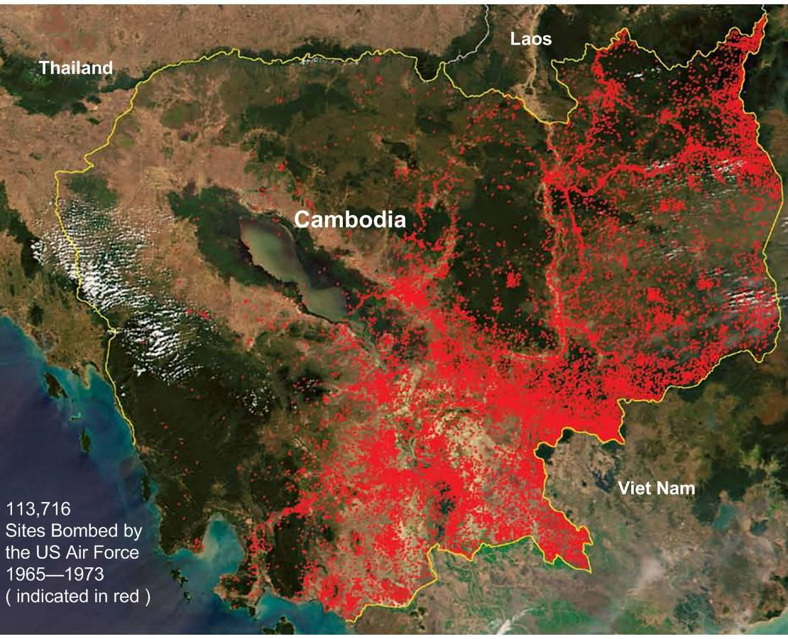
The Vietnam War, the American Bombings, and the Cambodian Civil War (Cont'd)
But in Cambodia, almost 3 million tons of bombs were dropped.
The US carpet bombing was unprecedented, causing destruction and civilian death.
Hundreds of thousands of Cambodians were killed.
The bombing forced the Vietnamese Communists deeper and deeper into Cambodia.
The bombs drove ordinary Cambodians (traumatized, angry, scared, and vulnerable) into the arms of the Khmer Rouge.
The Khmer Rouge won the Civil War and took control of the country in 1975.
What happened throughout the next four years?

Slide 6
The Cambodian Genocide, Killing Fields, and Reign of Terror
The Khmer Rouge's revolution was the Cultural Revolution for the Cambodian poor, peasants, and workers.
They wanted to transform Cambodia into an agrarian utopia, a new society free of the vestiges of the past.
They abolished everything: Money, religion, private property, books, Western medicine and technology, etc.
They relocated Cambodian people from cities to the countryside and forced them to work hard on the land (against their will and without any compensation).
They committed genocide and other crimes against humanity, such as mass killings, torture, persecution, enslavement, ethnic cleansing, family separation, and forced displacement, forced marriage, forced labor, etc.
They systematically killed government officials and soldiers from the previous regime, intellectuals, celebrities, and other enemies of the people.

Slide 7
The Cambodian Genocide, Killing Fields, and Reign of Terror (Cont'd)
Approximately 2 million Cambodians (out of an 8 million population) had perished, due to execution, overwork, starvation, and diseases.
Some of the Khmer Rouge's mottoes: Killing you is no loss, keeping you is no gain, making fertilizer out of you, making a mistake killing you is better than letting you live, etc.
The Khmer Rouge's reign of terror lasted for almost 4 years.
Then the Vietnamese troops invaded Cambodia and toppled the Khmer Rouge regime responsible for the Killing Fields.
The Khmer Rouge guerrillas retreated to the jungles and continued to fight against the Vietnamese occupiers and the new government of Cambodia.
The “Killing Fields” was released in 1984. It was an iconic movie depicting the killing fields under the Khmer Rouge regime. I strongly recommend that you watch this movie to better understand what happened during the Killing Fields of Cambodia (if you haven’t seen this movie yet).
Cambodian skulls at Tuol Sleng Genocide Museum

Slide 8
The Vietnamese Occupation, the Escape to Thailand, and the Refugee Camps
The Vietnamese troops invaded Cambodia in the late 1978 and took control of Phnom Penh, the capital city, in early 1979.
The goal for Vietnam was to remove the genocidal Khmer Rouge regime from power.
The Vietnamese invasion and occupation forced hundreds of thousands of Cambodians to flee to Thailand, in fear and in pursuit of refuge and safety.
The trek to Thailand was fraught with dangers: The armed robberies, the Khmer Rouge guerrillas, the Vietnamese troops, the Thai soldiers, the paramilitary resistance groups fighting to liberate Cambodia, and worst of all, the landmines.
Cambodia was one of the most landmine-affected countries in the world.
Millions (an estimate of 4 to 6) of landmines and unexploded bombs scattered throughout the country, maiming and killing Cambodian men, women, and children.

Slide 9
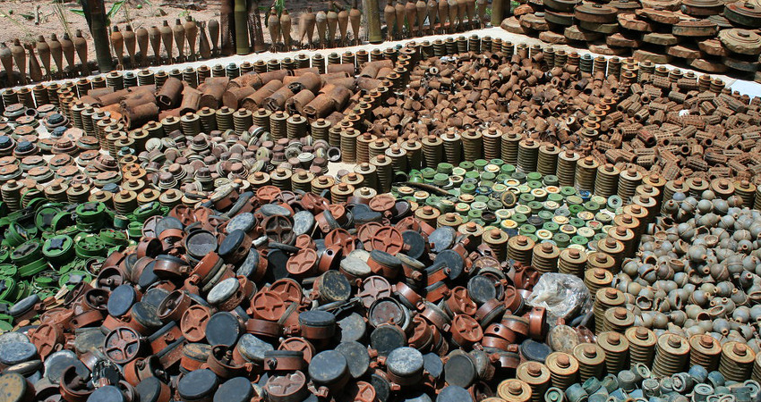
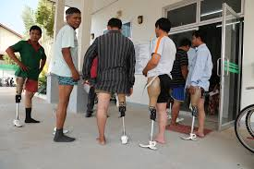
Landmines at Cambodia Landmine Museum and Cambodian Amputees at Limbs International

Slide 10
The Vietnamese Occupation, the Escape to Thailand, and the Refugee Camps (Cont'd)
Cambodia had one of the highest rates of amputees in the world, prior to the peace agreement and the demining activities in 1991.
Many refugee camps were established along the Thai-Cambodian border and inside Thailand (Khao-I-Dang, Kamput, Sakeo, etc.) for Cambodian refugees fleeing their homeland.
Hundreds of thousands of Cambodian refugees were resettled in the United States (and other third countries) in the early 1980s and 1990s.
The "unfortunate ones" (approx 360,000 of them) were repatriated to Cambodia, emptying and closing all refugee camps in the early 1990s.
The "fortunate ones" resettled in the United States continued to have difficulty coping with their traumas and acculturation problems.

Slide 11
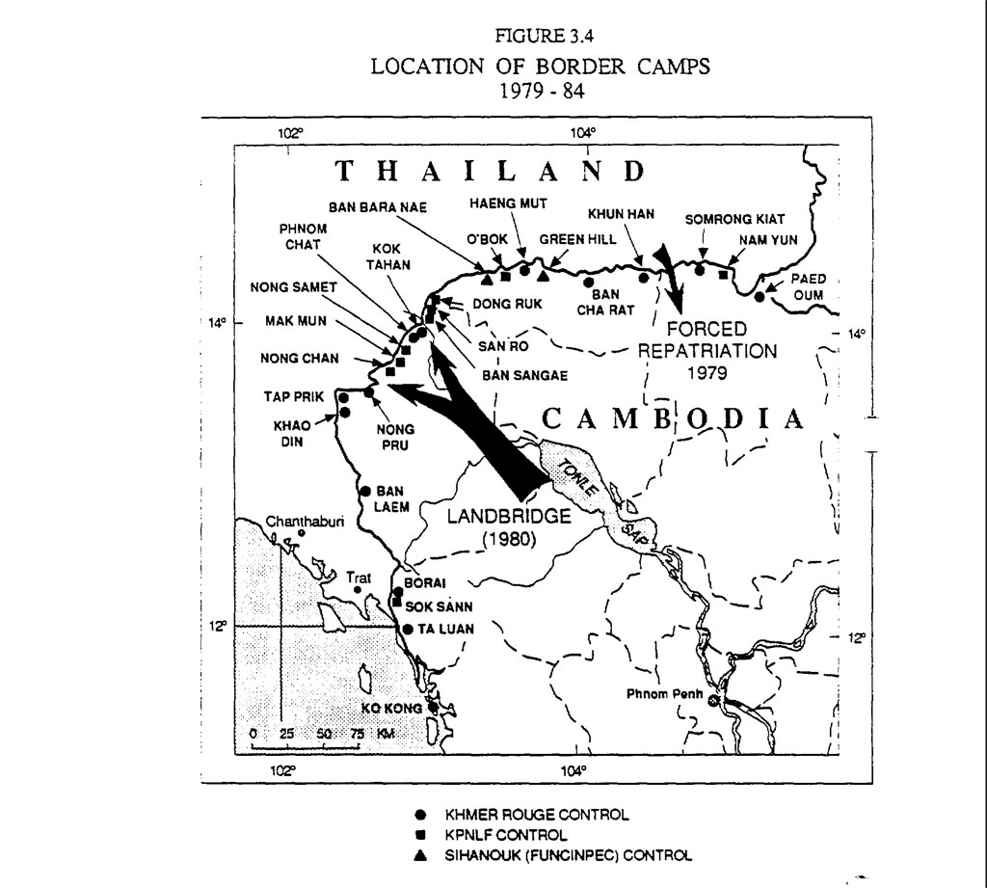
Map of refugee camps along the Thai-Cambodian border

Slide 12
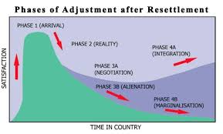
The Resettlement and the Phases of Refugee Adjustment
Cambodian refugees were resettled in different states throughout the United States.
Dr. Dennis Hunt’s refugee adjustment is in four phases.
The Reality phase is bifurcated into
two different paths:
the Path to Integration and
the Path to Marginalization.

Slide 13
The Resettlement and the Phases of Refugee Adjustment (Cont’d)
During the Arrival Phase, refugees had the following psychosocial experiences: high expectations; relief to be out of dangerous situations; gratitude for being safe; hope for the future; confusion and disorientation; anger, resentment, or frustration with barriers to becoming self- and family-supporting (language, cultural differences, discrimination, etc.).
During the Reality Phase, refugees had the following psychosocial experiences: culture shock; awareness of challenges and difficulties; feeling overwhelmed and fatigued; memories of traumatic events, flashbacks, outbursts, sleep problems, hypervigilance, etc.; an increase of somatic complaints (headache, stomachache, heart palpitations, breathlessness, nonspecific joint and back pains, etc.).
During the Negotiation Phase, refugees had the following psychosocial experiences: healing from trauma (learning to cope with fear/guilt for family members back home); commitment to succeed and gain a sense of hope; adapting or learning new problem-solving methods to meet the challenges of adjustment; seeking more autonomy and independence (a growing sense of determination and control).
During the Integration Phase, refugees had the following psychosocial experiences: gaining a sense of power and control, self-confidence; coping with the psychological and physical effects of torture and other trauma; forging a bicultural identity; pride in self-sufficiency, autonomy, and independence; confidence in strengths and resources, a sense of success and stable future.
During the Alienation Phase, refugees had the following psychosocial experiences: anxiety, fear, reluctance to leave home; isolation and withdrawal; despair and sadness over losses (family status/old roles, language, culture, way of life, homeland, etc.); fear about succeeding in making a new life.
During the Marginalization Phase, refugees had the following psychosocial experiences: hopelessness (has given up hope of acculturating or having a positive role); resentment and/or negative attitude; despair and sadness over losses (increases in chronic depression); difficulty getting or providing emotional support to self or family, yet may be dependent on family members to meet basic needs.

Slide 14
The Resettlement, the Phases of Refugee Adjustment, and the Acculturation Process
The adjustment process is different from the acculturation process. All migrants (be they sojourners, immigrants, or refugees) will acculturate at different rate, depending on their risk factors and protective factors.
Acculturation is the dual process of cultural and psychological change that takes place as a result of contact between two or more cultural groups and their individual members.
At the individual level, acculturation involves changes in a person’s behavioral repertoire. These cultural and psychological changes come about through a long-term process, sometimes taking years, sometimes generations, and sometimes centuries.
Acculturation can result when groups of individuals having different cultures come into continuous first-hand contact with subsequent changes in the original culture patterns of either or both groups.
John Berry’s research has identified four acculturation strategies: (1) Assimilation, (2) Separation, (3) Integration, and (4) Marginalization.

Slide 15
The Resettlement, the Phases of Refugee Adjustment, and the Acculturation Process
When individuals do not wish to maintain their cultural identity and seek daily interaction with other cultures, the Assimilation strategy is defined.
When individuals place a value on holding on to their original culture, and at the same time wish to avoid interaction with others, then the Separation alternative is defined.
When there is an interest in both maintaining one’s original culture, while in daily interactions with other groups, Integration is the option.
When there is little possibility or interest in cultural maintenance, and little interest in having relations with others, then Marginalization is defined.
My Cambodian clients typically fall into two groups: Separation (adults and older adults) and Marginalization (children and youth).
Those in the Integration and Assimilation groups usually don’t require culturally sensitive services much.
Integrated individuals are bilingual and bicultural, navigating both cultures, while Assimilated youth adapt well to mainstream culture. However, cultural clashes at home remain a challenge.

Slide 16
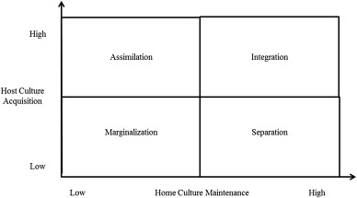
Berry’s Model of Acculturation: The Four Strategies to Acculturate

Slide 17
Cambodian Refugees 10 Years After Their Resettlement
From 1978 to 1991, more than half a million Cambodian refugees in Thailand refugee camps.
Approximately 500 Cambodian refugees were resettled in Greensboro, North Carolina.
Fifty adults (26 women and 24 men) were selected for the study.
Subjects' age ranged from 21 to 65.
Most subjects were found to experience extremely high levels of PTSD, depression, and anxiety.
The rates of PTSD, depression, and anxiety were extremely high: 86%, 80%, and 78%, respectively.
These refugees were suffering considerable mental distress, yet they have not sought mental health treatment.
Cambodian refugees experienced extreme hunger, fear, and death of loved ones.
Conditions in refugee camps were extremely poor: hunger and disease were continual threats.

Slide 18
Cambodian Refugees Two Decades After The Resettlement
By the time they were resettled, most of them had experienced many severe traumas, including the deaths of loved ones, witnessing and experiencing torture, forced migration, and the loss of all personal possessions.
A total of 586 adults aged 35 to 75 living in Long Beach, California, were selected for the study.
But only 87% (490) of them responded, and these respondents were interviewed in Khmer.
Sixty-one percent of the respondents were women and 87% indicated Buddhism as their religious affiliation.
The majority of respondents were married and low in socioeconomic status, with low levels of education, English-speaking proficiency, and employment.
Participants reported high rates of exposure to trauma and violence before they arrived in the United States.
Reported experiencing a mean of 15 of 35 premigration trauma types.

Slide 19
Cambodian Refugees Two Decades After The Resettlement (Cont'd)
Examples: 99% of individuals reported near-death due to starvation, 96% reported forced labor (like animal or slave), 90% reported having a family member or friend murdered, and 54% reported having been tortured.
62% of respondents met diagnostic criteria for PTSD and 51% met diagnostic criteria for major depression in the past year.
In terms of comorbidity, 71% of them with PTSD also met the criteria for major depression and 86% of them with major depression met the criteria for PTSD.
Low levels of probable alcohol use disorder (AUD) were found (among 4% of them).
Respondents with poor English-speaking skills, unemployment, being in retirement or disabled, and living in poverty were associated with higher rates of PTSD and major depression.
Older respondents showed higher rates of PTSD and depression than did younger participants.
Older respondents had lower rates of probable AUD than did younger respondents.

Slide 20
Cambodian Refugees After Four Decades of Resettlement
Refugees escaping organized violence are prone to mental health complications, such as PTSD, depression, adjustment disorders, and grief-related disorders.
Cambodian refugees experienced life-threatening events daily during the genocide, in refugee camps, and post-resettlement.
A host of psychological comorbidities, physical illnesses, substance abuse, poverty, low levels of education and social capital has been identified at the individual level.
An ethnographic needs assessment was conducted from May to August 2022, utilizing the principles of Critical Ethnography.
Eighteen professionals (psychologist, social worker, therapist, case manager, director, etc.) serving Cambodian families across the US (i.e., California, Massachusetts, Pennsylvania, Minnesota, Washington, and Connecticut) were interviewed virtually.
The theme of psychological trauma was reported across generations at post-resettlement.
The grandparent generation continues to suffer from mental disorders (i.e., PTSD, depression, anxiety attacks, hallucinations, suicide ideation/attempts, complicated grief, acculturation stress, etc.) due to their prolonged exposure to genocide trauma, refugee camps, and post-resettlement stress.

Slide 21
Cambodian Refugees After Four Decades of Resettlement (Cont'd)
The parent generation whose childhoods were severely disrupted during the genocide and life in refugee camps presented behavioral issues (i.e., Oppositional and Defiant Disorder and Attention Deficit Hyperactive Disorder) along with mood disorders (i.e., anxiety disorders, anger outbursts, depression).
The theme combined maladaptive and adaptive coping strategies were reported by all informants.
Maladaptive coping includes gambling, excessive drinking, and abusing substances in the grandparent and parent generations.
Adaptive coping strategies, such as participating in community gardening and cooking, volunteering at Buddhist temples, joining meditation groups, and exercising were reported.
The theme of lack of culturally tailored services emerged in the responses of all the participants when asked about the offered services specifically structured to meet the needs of Cambodian refugee families.

Slide 22
Cambodian Refugees After Four Decades of Resettlement (Cont'd)
The informants stated that many services remain inaccessible to the Cambodian refugee population, due to a lack of understanding and cultural knowledge of service providers.
Trauma exposures during the genocide, refugee camps, and post-resettlement continue to impact Cambodian refugee communities four decades after resettlement.
Key informants reported that PTSD, depression, anxiety disorders, and a host of mental health complications continue to plague Cambodian refugees.
Mental illnesses were reported across generations, but most severely among the grandparent and parent generations.
The grandchildren generation born post-resettlement commonly battle depression, anxiety disorders, and behavioral problems.

Slide 23
Working with Cambodian Refugees, Immigrants, and their Families: Utilizing a Culturally Informed Approach to Mental Health
In 1999, I was hired to work at Gardner Health Services (Gardner), starting as a Mental Health Specialist, Mental Health Rehabilitation Specialist, and then Mental Health Therapist.
I got hired not just because I have a psychology degree. I got hired because I know Cambodian culture. I can also speak Cambodian or Khmer.
I was tasked to develop a program that serves traumatized Cambodian adults and older adults and their families.
Gardner’s mission: To provide high-quality, comprehensive medical and mental healthcare, including prevention and education, early intervention, treatment and advocacy services that are affordable, respectful, culturally, linguistically and age-appropriate.
After consulting with my program supervisor, we agreed that our program should be culturally, linguistically, and age-appropriate, and provide mental healthcare services that are family-focused and wellness-focused.

Slide 24
Working with Cambodian Refugees, Immigrants, and their Families: Utilizing a Culturally Informed Approach to Mental Health (Cont’d)
Wellness is a holistic integration of physical, mental, and spiritual well-being, fueling the body, engaging the mind, and nurturing the spirit. Although it always includes striving for health, it’s more about living life fully, and is “a lifestyle and a personalized approach to living life in a way that…allows you to become the best kind of person that your potentials, circumstances, and fate will allow” (Stoewen, D.L., 2017, p.861).
The Cambodian Family Wellness Project was developed, offering family-focused mental health services to low-income Cambodians in Santa Clara County and providing linguistically and culturally sensitive counseling (including rehabilitation, crisis intervention, and therapy), case management, and medication support services.
Santa Clara County in California described rehabilitation as “a service activity which includes, but is not limited to, improving, maintaining, or restoring a beneficiary’s or group of beneficiaries’ functional skills, daily living skills, social and leisure skills, grooming and personal hygiene skills, meal preparation skills, and support resources; and/or medication education.”
Therapy means “a service activity, which is a therapeutic intervention that focuses primarily on symptom reduction as a means to improve functional impairments.”

Slide 25
Working with Cambodian Refugees, Immigrants, and their Families: Utilizing a Culturally Informed Approach to Mental Health (Cont’d)
Crisis intervention means “a service, lasting less than 24 hours, to or on behalf of a beneficiary for a condition that requires more timely response than a regularly scheduled visit.” CI is an immediate emergency response that is intended to help the individual cope with a mental health crisis (e.g., potential danger to self or others, potential life-altering event, severe reaction that is above the client’s normal baseline, etc.
Targeted case management means “services that assist a beneficiary to access needed medical, educational, social, prevocational, vocational, rehabilitative, or other community services.”
Medication support services are those services that include prescribing, administering, and dispensing. Medication support services are services that include prescribing, administering, dispensing, and monitoring psychiatric medications or biologicals necessary to alleviate the symptoms of mental health conditions and illness.
Dr. Daryn Reicherter, a psychiatrist, has worked with Cambodian refugees at Gardner Health Services for over 19 years. He provides a combination of administrative and clinical services in the area of “cross-cultural” trauma and mental health.

Slide 26
Working with Cambodian Refugees, Immigrants, and their Families: Utilizing a Culturally Informed Approach to Mental Health (Cont’d)
Traumatized Cambodians had scars on their bodies, minds, and souls. Yet they were reluctant to seek help and were known to underutilize mental health services. Why?
The answers were found in the following qualitative study conducted in Australia: What are the factors that influence Asian communities’ access to mental healthcare?
This qualitative study recruited 10 participants (three women and seven men) whose ages ranged from 30 to 75. The majority of them were health professionals. Participants were interviewed between October and November 2003.
Six main themes were identified: (1) Shame and stigma, (2) causes of mental illness, (3) family reputation, (4) hiding up, (5) seeking help, and (6) lack of collaboration.
Shame and stigma prevented migrants (sojourners, immigrants, and refugees) from seeking help from mainstream mental health services.
Knowledge about the cause of mental illness depends on the person’s beliefs, such as karma, evil spirits, and bad blood.
Cambodians believed in all these and more as the causes of mental illness (such as black magic, being cursed, and being crazy).

Slide 27
Working with Cambodian Refugees, Immigrants, and their Families: Utilizing a Culturally Informed Approach to Mental Health (Cont’d)
The Cambodian Family Wellness Project and its culturally competent staff members were (and continued to be) able to destigmatize mental illness utilizing the ABC+S Model.
ABC+S stands for Affect (emotions, feelings, etc.), Behavior (action, habits, lifestyles, choices, etc.), Cognition (thinking, beliefs, values, etc.), and Social relationship and environment.
When working with Cambodian clients, we educated them about mental illness versus mental health. We put the emphasis on the “mental health” and described their mental health issues in terms of affective (emotional), behavioral, cognitive, and social problems.
We matched our Cambodian clients with our Cambodian clinicians who understand each other’s language and culture.
We were willing to meet our clients wherever they feel comfortable, safe, and secure (at Gardner clinic, their homes, schools, Buddhist temples, medical clinics, community centers, etc.)
We provided free transportation to clients who are unable to drive and/or scared to take the public transportation. And in some special cases, we drove and accompanied our clients to their appointments (with their doctors and/or other service providers).

Slide 28
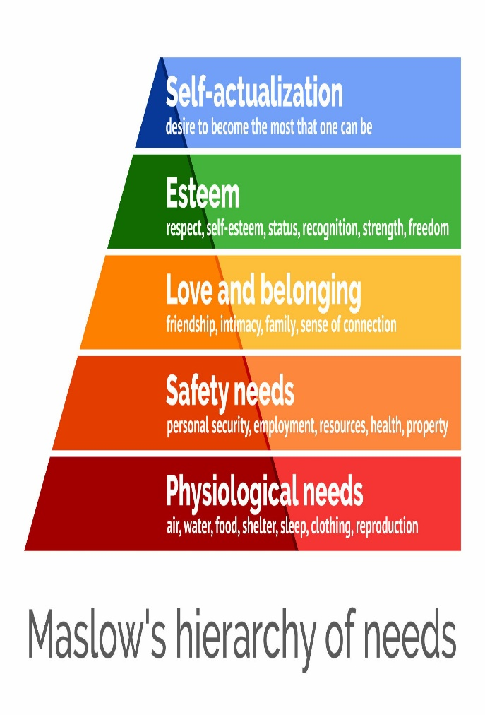
Working with Cambodian Refugees, Immigrants, and their Families: Utilizing a Culturally Informed Approach to Mental Health (Cont’d)
As case managers, rehabilitators, and therapists, we were privileged, honored, and committed to helping our clients to utilize community resources, to access healthcare services, to navigate the systems, and/or to meet their basic needs.
Targeted case management was an integral part of service delivery. Cambodian clients sought culturally and linguistically appropriate services because they were having unmet needs.
They were overwhelmed, damaged, and in bad shape. They were having a multitude of psychosocial problems (financial hardship, housing issues, language barrier, lack of transportation, family conflicts, health conditions, etc.) that needed to be dealt with.
We were able to help our clients overcome their challenges and deal with their problems step by step utilizing Maslow’s Hierarchy of Needs.
Abraham Maslow theorized that there are five categories of needs that motivate people to act. When their basic needs are met, then they are motivated to move to other more advanced needs.
The “five categories of needs” are (1) physiological needs, (2) safety needs, (3) love and belonging, (4) esteem, and (5) self-actualization.
While helping our Cambodian clients with history of distrust and underutilization of services, we cherished (valued or took advantage of) every opportunity to build trust and rapport with them and their families.

Slide 29
Working with Cambodian Refugees, Immigrants, and their Families: Utilizing a Culturally Informed Approach to Mental Health (Cont’d)
Case management was the most desired and sought-after type of services for Cambodian clients. Thus, case management became a vehicle for other mental health services. Rehabilitation, therapy, and medication support services were adjunct to case management.
To better serve our Cambodian clients, we started groups for youth, men, and parents. Then we had our Meditation group, which will be discussed further. Groups were psychoeducation in nature, and the purposes were to develop life skills, to provide support, to share experiences, to bridge the intergenerational gap, and/or to improve family relationships.
For Cambodian Men’s and Parenting Groups, we discussed adjustment difficulty, acculturation problems, role reversal and incapacity, parenting styles, etc.
When providing group and/or individual psychoeducation on Parenting Styles, I utilized the four different types of parenting styles (pioneered by Baumrind), such as authoritarian, authoritative, permissive, and uninvolved.
Authoritative parenting style was considered ideal and Cambodian parents were taught to understand the effects of their demandingness and responsiveness.

Slide 30
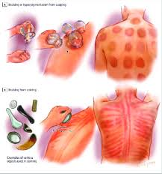
Working with Cambodian Refugees, Immigrants, and their Families: Utilizing a Culturally Informed Approach to Mental Health (Cont’d)
The Australian study also found that people from Asian communities, who have a mental illness, often access the healthcare systems with predominantly physical complaints. And the Cambodian community was no exception.
The DSM-IV and DSM-5 include Khyal cap in the “Glossary of Cultural Concepts of Distress.”
Khyal cap, or wind attacks, is a syndrome found among Cambodians in the United States, Cambodia, and elsewhere. Common symptoms include those of panic attacks, such as dizziness, palpitations, shortness of breath, and cold extremities, as well as other symptoms of anxiety and autonomic arousal (e.g., tinnitus and neck soreness).
Wind attacks may occur without warning but are frequently brought about by triggers such as worrisome thoughts, standing up (i.e., orthostasis), specific odors with negative associations, and agoraphobic type cues like going to crowded spaces or riding in a car.
Wind attacks usually meet panic attack criteria and may shape the experience of other anxiety and trauma- and stressor-related disorders.
Cambodians tend to use traditional healing practices (such as coining, cupping, and pinching) to treat Khyal cap, or wind attacks.

Slide 31
Working with Cambodian Refugees, Immigrants, and their Families: Utilizing a Culturally Informed Approach to Mental Health (Cont’d)
Research indicates that Cambodian refugees have poor English skills, minimal education, and high rates of illiteracy in the Cambodian language. They have sustained greater trauma than either Laotian or Vietnamese refugees.
Among psychologically distressed Cambodian refugees, somatic complaints are particularly prominent. Understanding that somatic symptoms are anxiety- and/or trauma-related is important when working with Cambodian clients.
Cambodian refugees have culturally specific somatic presentations: tinnitus, blurry vision, neck soreness, and cold and sore extremities. The following somatic symptoms were identified and described in relation to catastrophic cognitions and trauma associations: Dizziness, palpitations, abdominal sensations, cold extremities, joint discomfort and limb-muscle soreness, and neck tension.
Symptom presentations tend to be somatic, and the meaning and interpretation appear to be culture-related beliefs.
When working with traumatized Cambodians, a somatic-focused approach is suggested. It facilitates the obtaining of relevant clinical data, motivates the patient to participate in treatment, identifies pathological processes generating symptoms, and suggests which cognitive-behavioral techniques should be utilized.

Slide 32
Working with Cambodian Refugees, Immigrants, and their Families: Utilizing a Culturally Informed Approach to Mental Health (Cont’d)
I found the Multimodal Therapy technique (pioneered by Arnold Lazarus) extremely useful and helpful when working with Cambodian clients.
Lazarus used the acronym BASIC ID that stands for Behavior, Affect, Sensation, Imagery, Cognition, Interpersonal relationships, and Drugs/biology. These seven modalities can be used to explore during the assessment and intervention.
Behavior includes simple and more complex psychomotor skills and activities, and being alert to behavioral excesses and deficits.
Affect includes felt or reported feelings and emotions. And the presence or absence of particular feelings, as well as hidden or distorted feelings.
Sensation includes five major senses (such as sight, touch, hearing, smell, and taste), and being alert to pleasant and unpleasant reported sensations as well as sensations of which clients seem unaware.
Imagery comprises various mental pictures (or images) that exert influence on a client’s life. Imagery is especially useful with clients who tend to overuse the cognitive modality.
Cognitions are thoughts and beliefs, and the three faulty assumptions include the should, perfectionism, and external attributions.

Slide 33
Working with Cambodian Refugees, Immigrants, and their Families: Utilizing a Culturally Informed Approach to Mental Health (Cont’d)
Interpersonal relationships: the importance of social interest and interpersonal relationships.
Drugs (and/or biology) represent an important non-psychological modality. Neurological and biochemical factors can affect behavior, affective responses, cognitions, sensations, etc. This modality includes the following as well: overall appearance, physiological complaints or diagnosed illnesses, general health and well-being.
The “BASIC ID bridging” technique is a strategically useful tool for exploration, assessment, and/or intervention.
Over the years, I have learned that Cambodians tend to present with physical complaints. They tend to have multiple health conditions and take multiple medications. Thus, during intake and assessment, I would try to identify the primary modality. For Cambodian adults and older adults, their primary modality tends to be Drugs (i.e., medications and health conditions). Then I would use this “drugs” modality to bridge to (or explore) other modalities.
BASIC ID is a great starting point for identifying Presenting Concerns. Then I would use the Developmental Timeline to obtain information from prenatal to present time (starting at age 0, 2, 5, 6, 13, 14, 18, etc.).

Slide 34
Working with Cambodian Refugees, Immigrants, and their Families: Utilizing a Culturally Informed Approach to Mental Health (Cont’d)
With the Developmental Timeline, I would be able to identify and explore my clients’ significant life events during their premigration, migration, and post-migration. Then I would develop a Family Genogram to better understand their family relationships, dynamics, and structures (up to three generations).
I also used the PHQ-9 and GAD-7 to screen my Cambodian clients for anxiety and depression.
Research has shown that traumatized Cambodians had the highest rates of anxiety and depression (when compared with other Southeast Asians, such as Vietnamese and Laotians). Thus, this mnemonic “Mad, Sad, and Nervous” was useful when assessing clients. But when it comes to Cambodian clients, this mnemonic should be in reverse (Nervous, Sad, and Mad). These are the top three most common groups of disorders among my Cambodian clients.
What are Nervous, Sad, and Mad disorders?
Nervous disorders are Anxiety disorders, including adjustment disorder with anxiety, obsessive-compulsive, and illness anxiety disorder.
Sad disorders are mood disorders that include major depressive disorder, adjustment disorder with depressed mood, dysthymic disorder, and bipolar affective disorder.
Mad disorders are psychotic disorders that include schizophrenia, schizophreniform disorder, schizoaffective, and delusional disorder.
The causes of psychotic disorders (schizophrenia), according to our Cambodian clients’ beliefs, are as follows: being cursed, persecuted by evil spirits, karma-related; possessed and controlled by a ghost or ghosts.

Slide 35
A Culturally Informed Approach to Mental Health, and the Development and Implementation of the Pilot Psycho-Social-Cultural Treatment Group Program
The Pilot Psycho-Social-Cultural Treatment Group Program, or the Meditation Group, was a project that involved, supported, and assisted by many colleagues and managers (the Mental Health Director, Programs Coordinator, Programs Supervisor, psychiatrist, and staff members).
I was asked to co-facilitate a Meditation Group program that combines Cambodian cultural traditions and Buddhist philosophy with Western mental health techniques.
The pilot Meditation Group was administered by two bilingual and bicultural Cambodian Mental Health Rehabilitation Specialists and a Buddhist monk as a paraprofessional.

Slide 36
The Pilot Psycho-Social-Cultural Treatment Group Program
The Buddhist monk, a paraprofessional, was invited to Cambodia multiple times during the Khmer Rouge Tribunal set up to prosecute the Khmer Rouge senior leaders and those considered most responsible for the Killing Fields and crimes against humanity.
Cambodian providers addressed mental health needs in spiritual terms and that the Buddhist temples were working in concert with the providers.
Gardner developed and implemented the pilot 12-week Meditation Group program to
(1) address compounded trauma and acculturation-related stress,
(2) somatization, and
(3) the perception of trauma and the adaptation process within a cultural value system, such as the concept of karma.
We already discussed that many Cambodian refugees frequently express their emotional and psychological distress in somatic ways.
The concepts of reincarnation and karma are Buddhist in nature. And Buddhism is deeply rooted in the Cambodian people’s beliefs and behaviors. Karma is defined as “the individual’s actions or thoughts in a prior existence that affect life in the present” (Hsu, Davies, & Hansen, 2004, p.198).

Slide 37
The Pilot Psycho-Social-Cultural Treatment Group Program (Cont’d)
Karma teaches that one reaps (in the current life) the fruits of what one has sown in the past or in the past life. Karma emphasizes the virtue of accepting and embracing anguish and pain willfully and mindfully.
It also teaches the importance of the “here and now” and a “future-oriented” approach. Thus, an approach cultivating mindful awareness of karma, along with the “here and now,” should be incorporated into treatment.
The pilot Meditation Group program adapted the Brahmavihara, another Buddhist concept, to address the cognitive thought process and restructuring.
Many traumatized Cambodian refugees had great difficulty reestablishing trust with others (after the Killing Fields) and tended to internalize a sense of their own worthlessness and powerlessness (or learned helplessness).
Brahmavihara consists of four virtues:
(1) Metta (loving-kindness),
(2) karuna (compassion),
(3) mudita (sympathetic joy), and (4) upekkha (equanimity).
Combined with mindfulness meditation and cognitive-psychological treatment (Brahmavihara), the modified family therapy approach was implemented to help Cambodian parents strengthen relationships with their children.

Slide 38
The Pilot Psycho-Social-Cultural Treatment Group Program (Cont’d)
Assessed its effectiveness: Gardner – SJSU partnership.
There were 57 Cambodian clients who received mental health services at Gardner and were eligible for this pilot study. Out of the 57 clients, only 9 participants (15.8%) were eligible to participate in this 12-week Meditation Group program. Among the 9 participants, females accounted for 77.8% and males accounted for 22.2% of the sample.
The clients ranged from 38 to 69 years of age, with a mean age of 54.0 years old.
All participants were refugees who had emigrated from Cambodia to the United States after the fall of Phnom Penh, the capital city of Cambodia, in 1975.
The findings demonstrated that the pilot Meditation Group program helped traumatized Cambodian clients reduce PTSD (Post-Traumatic Stress Disorder) symptoms and family-related acculturation stress.
Thus, the findings indicated that the combination of mindfulness meditation, cognitive-psychological treatment, and the modified family-treatment approach supported cognitive restructuring, or the ability to change disrupted and internalized thought processes that result from trauma.
The four Brahmavihara virtues seemed to elevate clients to a higher spiritual level, which helped counteract the harmful effects of mental defilements such as anger, envy, greed, and worry.
By working collaboratively with a Buddhist monk throughout the pilot program, the Gardner agency utilized a nontraditional service delivery effectively.

Slide 39
What Happened After the Pilot Psycho-Social-Cultural Treatment Group Program?
Erica Mu, a reporter, wrote an article titled “Finding Mental Health Somewhere Between East and West,” reporting on the Meditation Group co-facilitated by me and my colleague.
A book chapter about “The Cambodian Lotus Thrives Under a California Sun: How a Mental Health Clinic Partnered With a Khmer Buddhist Temple to Reach Killing Fields Refugees Living in California.”
NPR Showcase in 2022

Slide 40
A Culturally Informed Approach to Mental Health, the New H5 Model for Trauma and Recovery
The Cambodian Family Wellness Project was successful because we focused on family, wellness, and trauma. In 2014, the New H5 Model was released by the Harvard Program in Refugee Trauma. This H5 Model was compatible with our culturally informed approach to mental health, and thus it was utilized to treat our traumatized Cambodian clients.
The H5 Model “addresses the mental and physical health issues related to trauma suffered by refugees, the relationship between mental and physical health problems prevalent among refugee populations, the potential for trauma to persist in refugee camps, and the need for a new, more comprehensive model of refugee care” (p.3).
The H5 Model has five overlapping dimensions and the core of the model is the Trauma Story.
Trauma Stories are stories told by survivor patients of distressing and painful personal and social events. The Trauma Story has four elements, and the primary element is the Factual Accounting of Events, or what actually happened to the storyteller, i.e., the brutal facts.
Each trauma story reveals the survivor’s sociocultural history in miniature, depicting the traditions, customs and values in which their story is embedded. The storyteller cannot avoid revealing the Cultural Meaning of Trauma.

Slide 41
A Culturally Informed Approach to Mental Health, the New H5 Model for Trauma and Recovery (Cont’d)
The trauma story also provides a view into the survivor’s spiritual life: his or her capacity to achieve an Enlightened View of the World divorced from ugly and distressful emotions.
Often the survivor reaches deep insights when reflecting upon his or her situation, for example, coming to reject social beliefs or attitudes that say he or she is “bad” for having been involved in a tragic event. In every tragic event, there is an opportunity to uncover deep revelation and gain insights. These insights can prove very liberating.
The fourth and final element of the trauma story is the Listener-Storyteller Relationship. Storytellers are vulnerable to physical and emotional pain when they retell their stories; therefore, a listener’s patience and sensitivity are crucial. The storyteller is the teacher, and the listener is the student.
The Trauma Story is the centerpiece of the medical and emotional care of all patients who have experienced or are experiencing violence.
That’s why I always created a safe space and opportunity for my Cambodian clients to feel that they are being heard, understood, and supported in every session.

Slide 42
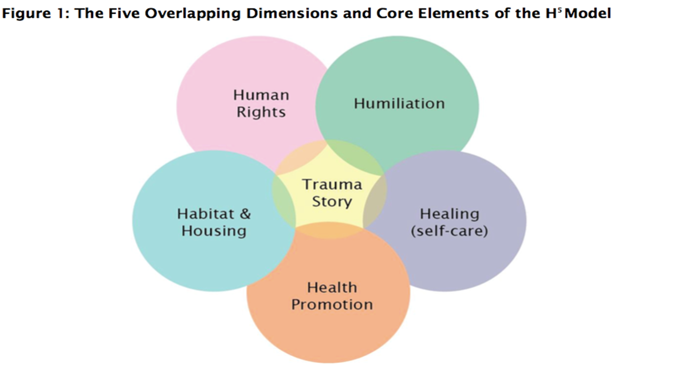
A Culturally Informed Approach to Mental Health, the New H5 Model for Trauma and Recovery (Cont’d)
The five overlapping dimensions of the New H5 Model include
(1) Human rights,
(2) Humiliation,
(3) Healing (Self-care),
(4) Health promotion, and
(5) Habitat.

Slide 43
The New H5 Model for Trauma and Recovery (Cont’d)
H1. Human Rights Violations: All acts of violence are human rights violations.
Safety and security is the foundation of refugee care. When safety and security are established, the individual’s traumatic life story must be recorded and acknowledged. All violated people expect and crave justice.
H2. Humiliation: Humiliation is closely associated with feelings of shame, embarrassment, disgrace, and depreciation.
The goal of violent acts is to create a state of emotional humiliation. Perpetrators try to introduce into the minds of their victims their fundamental worthlessness.
Humiliation leads to a total loss of self-respect and can have major impacts on a refugee’s personal and social behavior, being associated with learned helplessness, leading to a lack of self-efficacy.
The healing and recovery process must consciously strive to overcome in the mind distortions that produce feelings of helplessness and worthlessness. It is important to identify the feeling of humiliation and its associated emotions.
H3. Healing (Self-care): Self-healing is one of the human organism’s natural responses to psychological illness and injury.
Self-healing occurs when the mind is able to construct new meaning out of violence (e.g., being a victim versus a survivor). Self-healing involves a social dimension as well as a physiological one.
Positive social behaviors, such as altruism, work, and spirituality, enhance neurobiological processes that promote health and reduce the negative consequences of stress.
These behaviors and others, such as the use of humor, social support, and physical exercise, help the individual recover psychologically.

Slide 44
The New H5 Model for Trauma and Recovery (Cont’d)
H4. Health promotion: There is emerging evidence that refugees and those impacted by conflict have increased levels of long-term chronic illnesses attributable to their traumatic experiences and high levels of distress.
Persons who experience trauma are more likely to die younger, develop chronic illnesses (e.g., ischemic heart disease, diabetes) and severe social disabilities.
Trauma survivors have poorer behavioral health, smoke more, use alcohol and drugs more, exercise less, and have poorer eating habits resulting in obesity and the metabolic syndrome.
The connection between trauma and poor physical health demands a new emphasis on health promotion.
H5. Habitat: The word habitat is used in place of housing to connote the total surroundings and/or living environment occupied by refugees.
A reciprocal and positive relationship existed between the physical and natural environment.
Traumatized persons and communities need to enter into a healing environment that can begin to initiate the healing process.
A significant relationship between health problems, mental illness, crowding, lack of privacy and chronic violence.
The H5 Model is extremely relevant and useful to mainstream health and mental health programs. It is consistent with the values and culture of the trauma-informed care movement.
While the H5 Model was developed for refugee populations, it certainly can be applied to those communities that have been traumatized by crime, poverty, and catastrophic situations, such as 9/11 and hurricanes Sandy and Katrina.

Slide 45
A Culturally Informed Approach to Mental Health, and the Cambodian Family Wellness Project
I just introduced to you the tragic events that had happened to Cambodians during the premigration, migration, and post-migration.
A number of topics were discussed and illustrated—the resettlement, refugee adjustment, acculturation process, etc.
I shared my personal experiences and professional knowledge, skills, and cultural competence that I have acquired for the past 25 years at Gardner.
I also shared research data and models that I have used to work with traumatized Cambodians.
To diagnose our Cambodian clients with mental illness, we must rule out (1) medical conditions, (2) drug/alcohol use or abuse, and (3) culture. And Cambodian clients tend to have a number of co-existing medical and psychosocial problems impacting their mental health.
The information presented in this workshop focuses on the culturally informed approaches to working with Cambodian refugees, immigrants, and their families.
The Cambodian Program’s name has changed multiple times, but the treatment philosophy remains relatively the same.
I sincerely hope that you will apply what you have learned today in your work with Cambodian clients and/or other refugee/immigrant populations.

